Slide 1
Pomo learning
Cata – Gabi – Geo – Radu

Slide 2
What’s this all about?
Toe-may-toe
To-ma-to
Notes:
EPLATFORM FOR IMPROVING TEACHING AND LEARNING METHODS BASED ON POMODORO AND DATA DRIVEN INSIGHTS

Slide 3
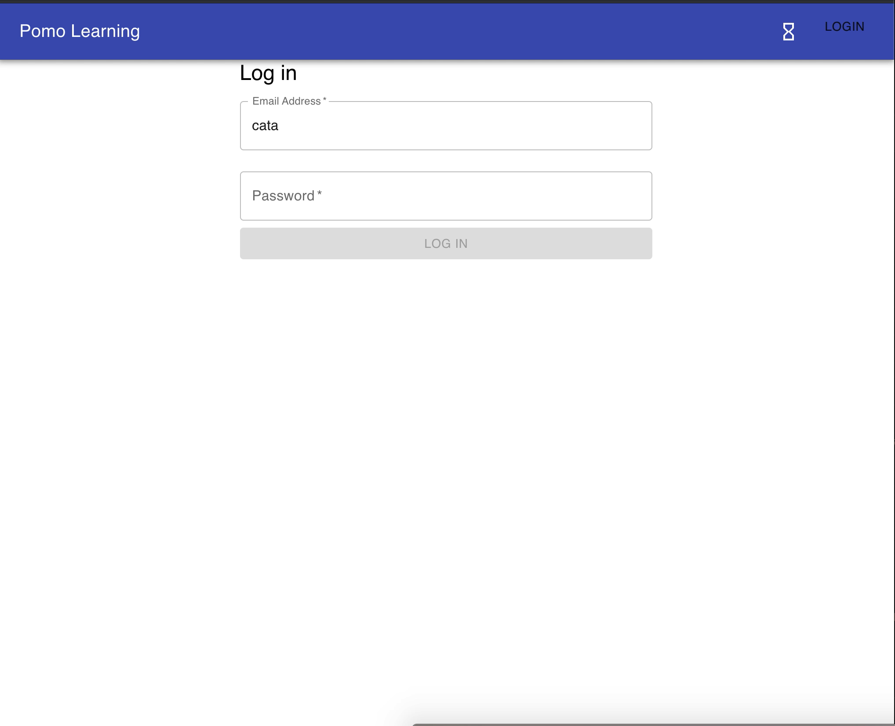
Teachers
BETTER STRUCTURED CONTENT with
guided input methods
INSTANT FEEDBACK through customized quizzes
INSIGHTFUL REPORTING based on student data

Slide 4
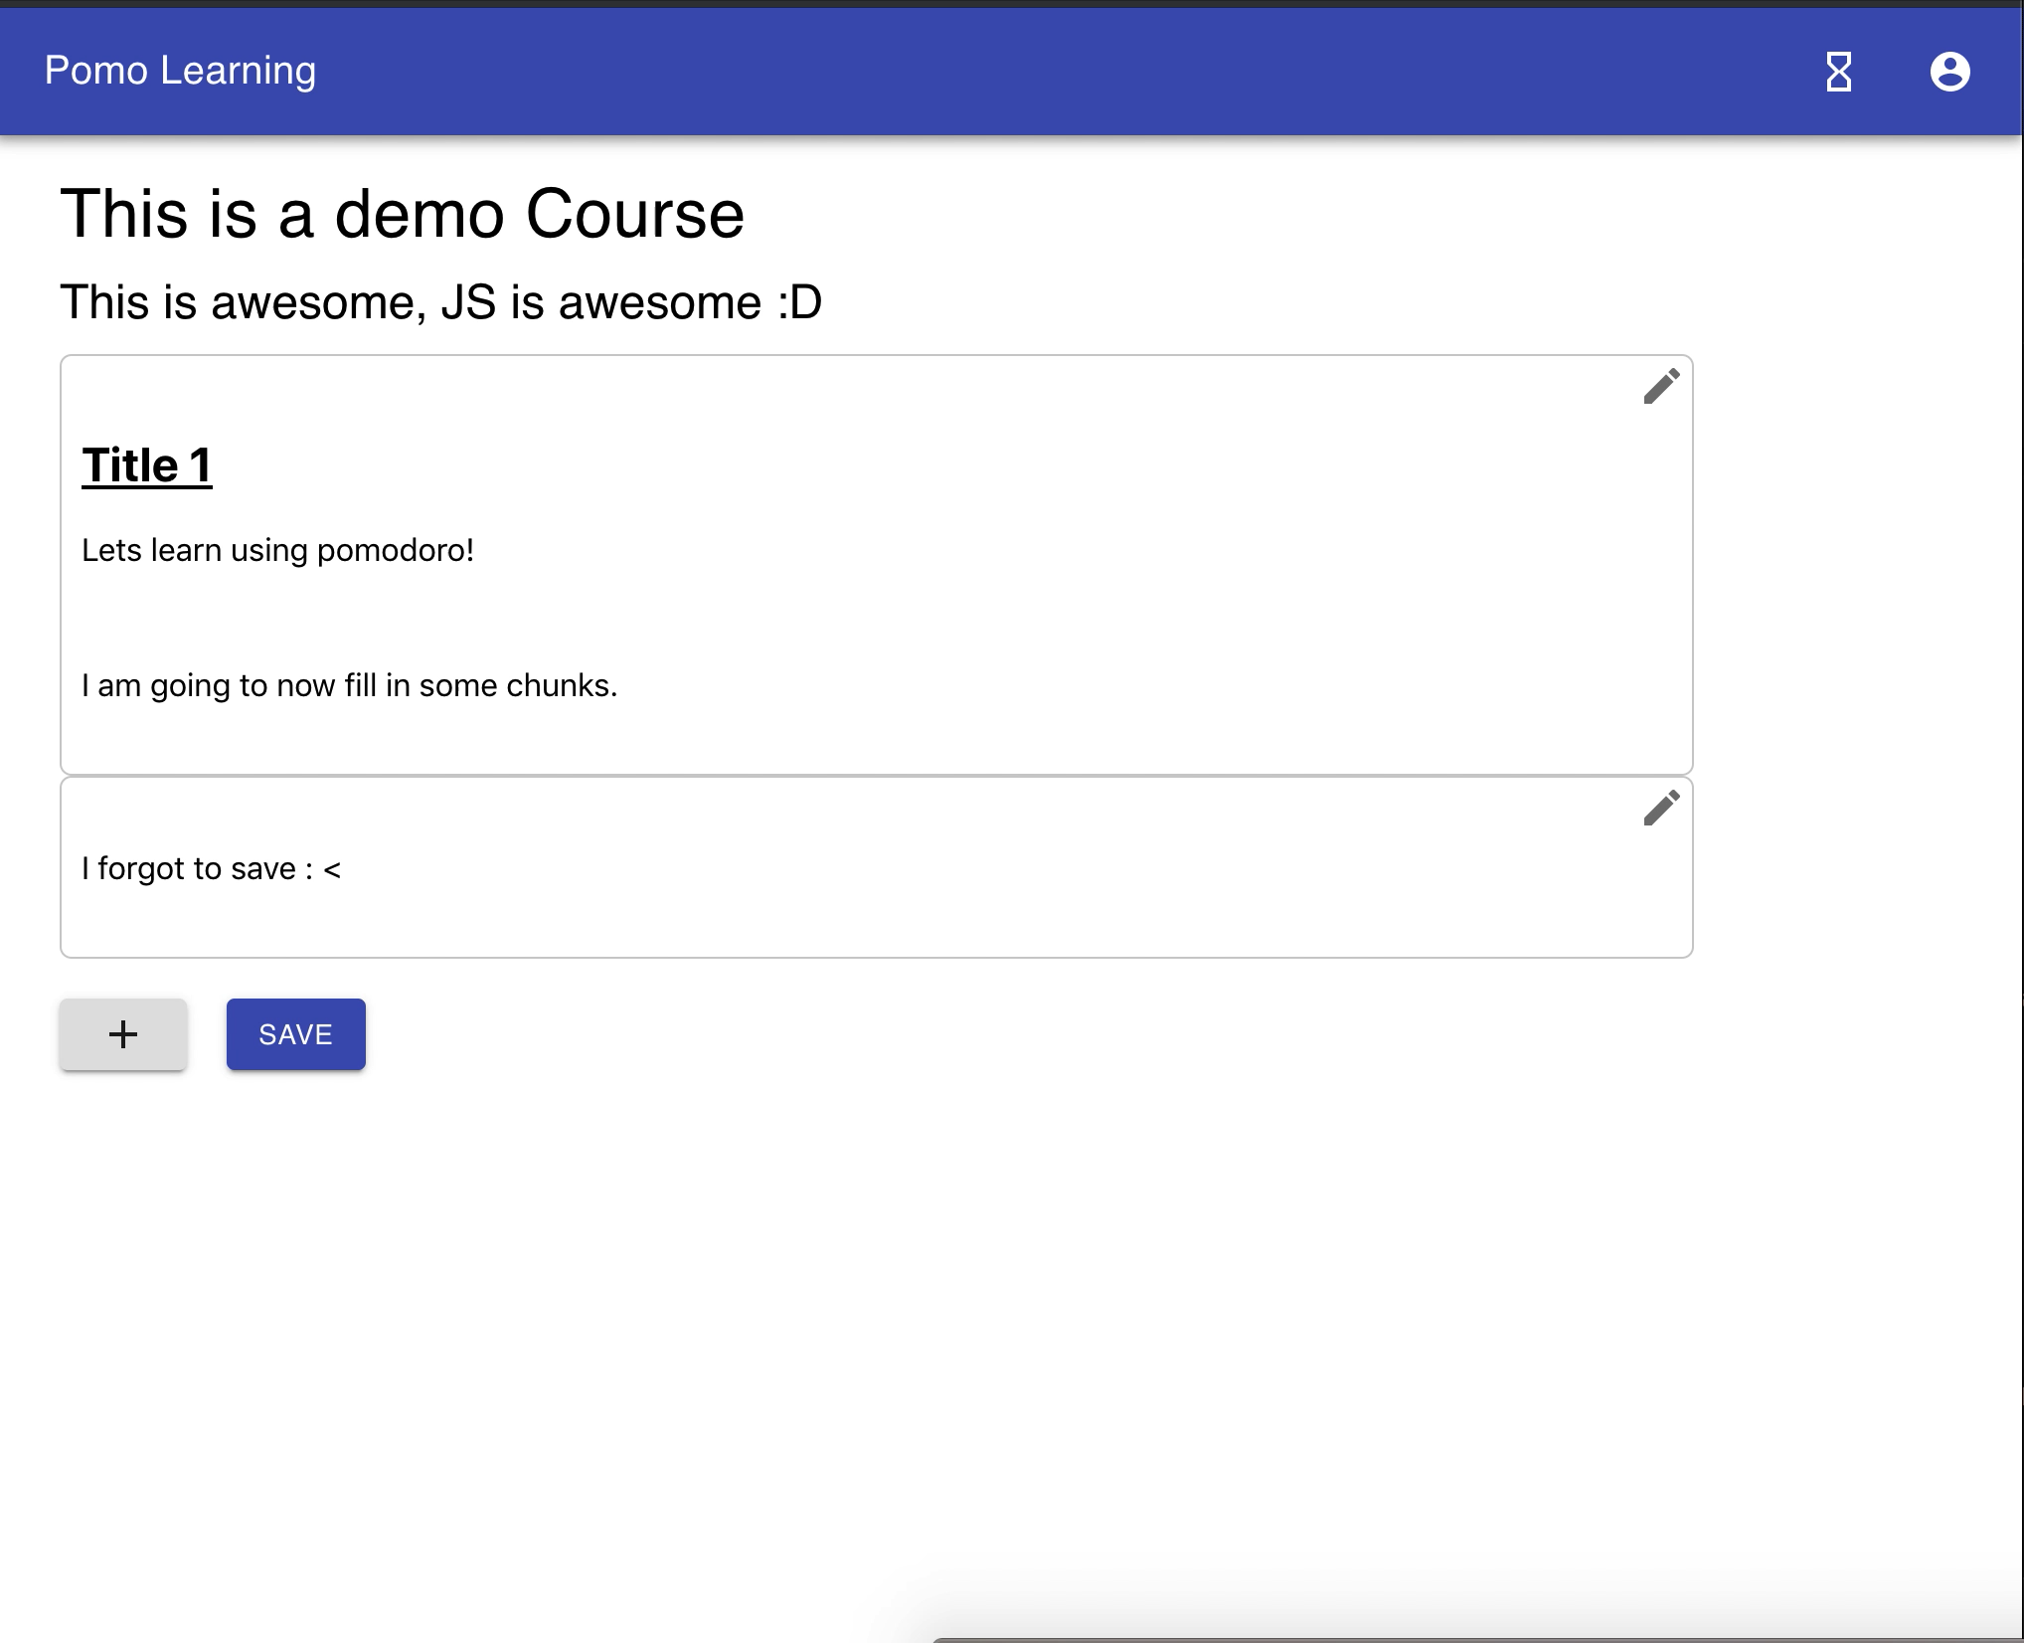
Students
PREVENT PROCRASTINATION with a personalized Pomodoro Technique
IMPROVE FOCUS by optimizing LT & RT rates
EARN ACHIEVEMENTS from completing your tasks

Slide 5

Thank you!
bl@nk – jshacks 2019

